Slide 1
Connecting public and private responses to COVID-19 and its impact on global development
Webinar series

Slide 2
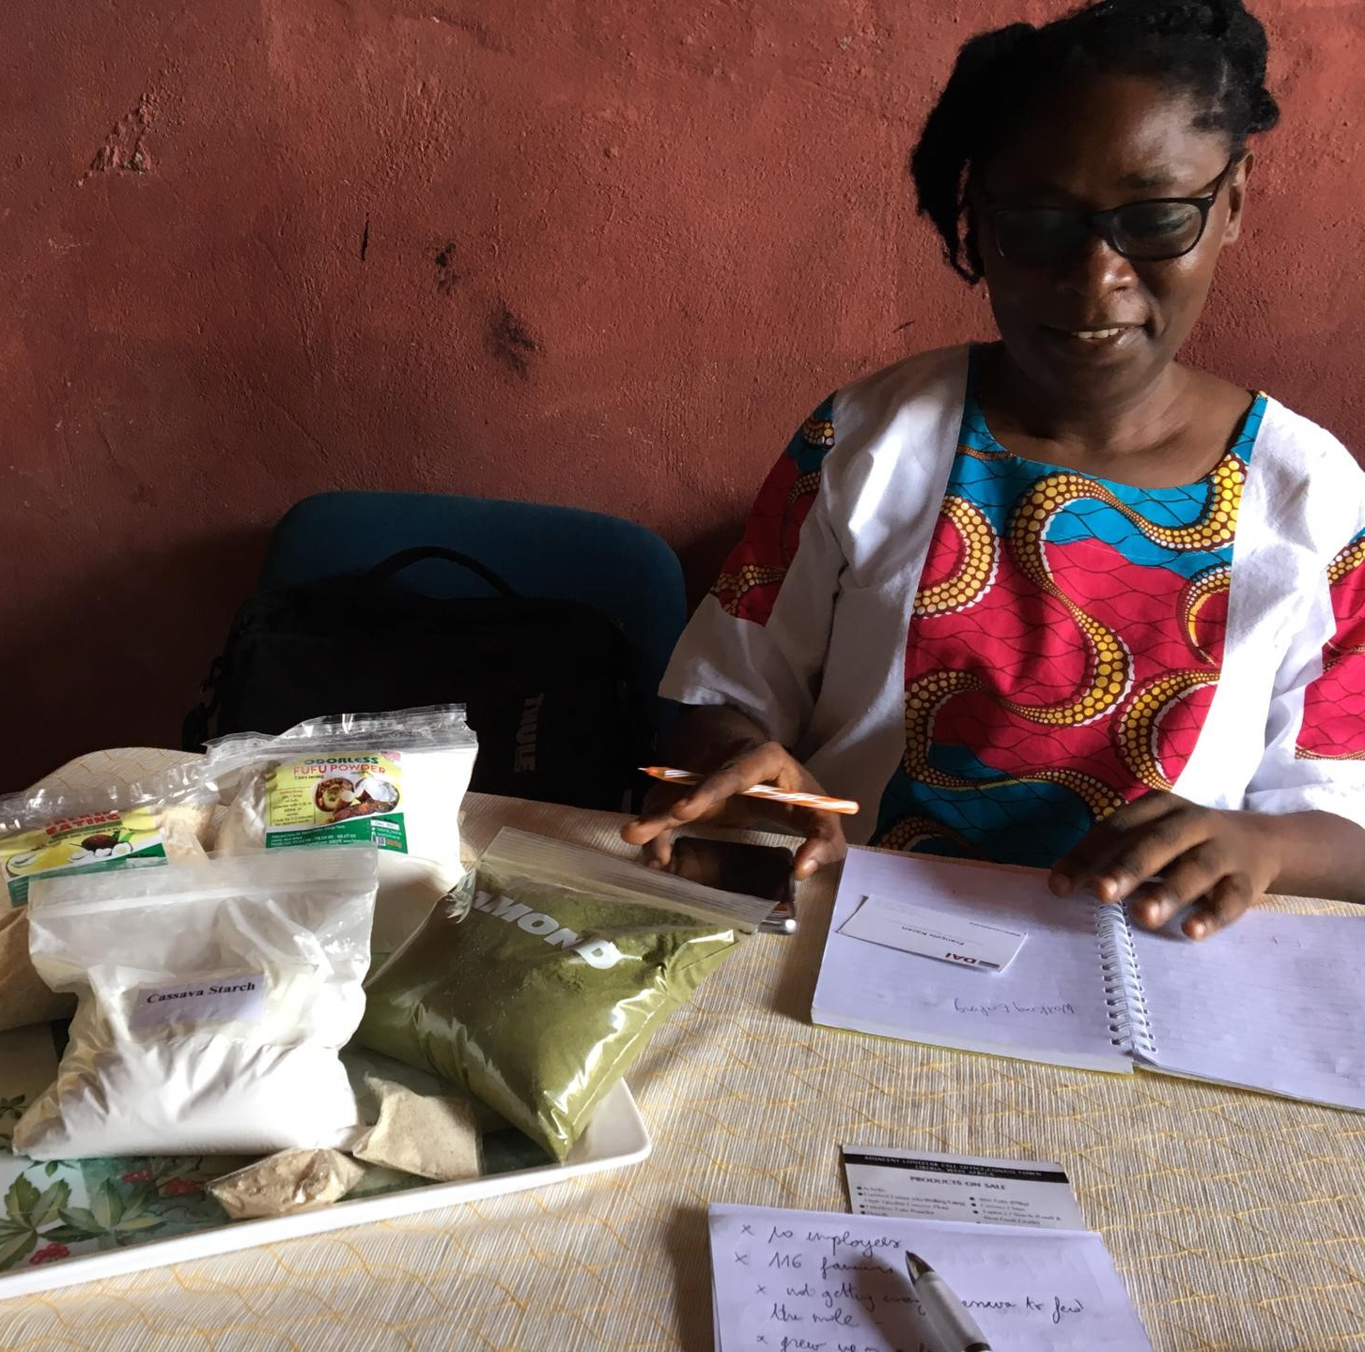
Supporting MSMEs for Economic Resilience and Sustainable Development
Webinar 1
Monday June 15th
3:00 to 4:15 pm CEST

Slide 3
Supporting MSMEs for Economic Resilience and Sustainable Development
^{SPEAKERS}
Saïd Abu Hijleh, DAI Country Director, Palestinian Territories
Eric Eloundou Ngah, Board member, Cameroon Business Patronage Movement (E.CAM)
Carole Karuga, Chief Executive Officer, Kenyan private sector organisation (KEPSA)
Emmanuel Moyart, Team Leader, EU Trade and Private Sector Development and Engagement (TPSD) Facility
^{FACILITATOR}
Jeske van Seters, Head of Programme Private Sector Engagement, ECDPM

Slide 4
Said Abu Hijleh, DAI Country Director, Palestinian Territories
A new reality
The world is going into a recession that will shape new economies. This recession will encapsulate small economies like the Palestinian economy. This encapsulation will force the private sector to start looking for local opportunities to survive.
On the positive side, the shift is accelerating rapidly the digital transformation of private sector organizations as well as driving others into fine-tuning their business models and product offerings in order to meet the demand of the new reality.
Although some changes are inevitable, the pandemic took businesses by surprise especially the startups and SMEs cash flow and financial projection plans.
Unemployment is predicted to rise significantly worldwide and in the West Bank and Gaza. Working hours have been reduced to a minimum, and even on the consumer demand side it is apparent that there is a shift toward only the essential spending.

Slide 5
Said Abu Hijleh, DAI Country Director, Palestinian Territories
The Innovative Private Sector Development Project (IPSDP)
A Palestinian Ministry of National Economy (MoNE) Project,
Funded by the World Bank and implemented by DAI.
Empowering the Palestinian economy through developing the private sector, with a focus on entrepreneurs, startups, and SMEs.
Finance for Jobs
A Palestinian Ministry of Finance (MoF) Project,
Funded by the World Bank and implemented by DAI.
Testing the effectiveness of selected financial interventions (DIP, EMG, ICF) in incentivizing private sector investment and job creation.

Slide 6
Said Abu Hijleh, DAI Country Director, Palestinian Territories
COVID-19 Response
Assisting the Palestinian private sector businesses dealing with the sudden and abnormal market dynamics.
F4J and IPSD are looking to move fast in providing COVID-19 Rapid Response Intervention which is a combination of financial (grants) and non-financial support (Mentoring, Training and Coaching) program to enable Business Survival and Continuity (referred to as Working Capital Bridge Grants).

Slide 7
Said Abu Hijleh, DAI Country Director, Palestinian Territories
Target group
Startups and Early-stage Enterprises | SMEs
Annual Sales turnover of less than $500,000 AND Full-time Employees of less than 15 AND Established after 2008 and no later than 6 months prior to the launch of the programme | Annual Sales turnover of more than $500,000 and less than $1,500,000 AND Full-time Employees less than 30

Slide 8
Said Abu Hijleh, DAI Country Director, Palestinian Territories
Working capital Bridge Grand Features
Financial Support
Non-Financial Support
In Kind Grant
3 months
USD 24,000 Ceiling
Covers Salaries, Rent and Limited IT equipment and software.
Retailoring businesses to enable adaptation, mitigation and continuity.
Coaching, Training and Mentoring
Mostly on-line

Slide 9
Eric Eloundou Ngah, Board member, E.CAM
Our presentation is divided into three parts:
Background of the Cameroonian economy in the COVID-19 context;
Response measures to COVID-19 and impact on the Cameroonian economy;
Structural solutions envisaged for strengthening the capacities of MSMEs and avenues for public-private partnership.

Slide 10
Eric Eloundou Ngah, Board member, E.CAM
The Cameroonian economy in the COVID-19 context
The optimistic economic growth forecasts announced at the beginning of 2020 are currently being called into question by a series of shocks, including the Coronavirus (COVID-19) pandemic ;
with the prospect of a global economic recession, marked in sub-Saharan Africa by a decline in real GDP of 1.6% in 2020, compared to 3.1% in 2019, rising to 4.1% in 2021 ;
Cameroon's formal economic fabric is specifically marked by a significant imbalance between the three production sectors, an extroverted and highly dependent nature of business activities vis-à-vis foreign countries, and a low level of domestic bank credit to the economy.

Slide 11
Eric Eloundou Ngah, Board member, E.CAM
Response measures and their impact on the economy
With regard to short-term measures, the main proposals are as follows:
The establishment of a consultation framework that would permit to centralize the results of COVID-19 business impact studies;
The creation of a sovereign guarantee fund with a minimum endowment of FCFA 1,000 billion (EUR 1.52 billion);
The reduction of the tax burden, particularly with regard to the forced collection of taxes and other social contributions, accompanied by an adjustment of the current payment deadlines until December 2020;
The establishment of an assistance mechanism for households covering their consumption needs in terms of food, health, transport, communication, water, electricity, etc.

Slide 12
Eric Eloundou Ngah, Board member, E.CAM
Structural solutions and avenues for PPP
The creation of a mutual guarantee company MSMEs in Cameroon:
At the macroeconomic level: the structuring of MSMEs into value chains ;
At the microeconomic level: the upgrading of MSMEs and the training of managers;
At the operational level: the establishment of a mutual guarantee company for MSMEs ;
At the financial level: the creation of a guarantee fund in which MSMEs also take part.

Slide 13
Eric Eloundou Ngah, Board member, E.CAM
Structural solutions and avenues for PPP
Development partners, such as the EU, the ADB, or the IFC will be able to intervene at three levels:
technical assistance to MSMEs through the training of managers and staff, the upgrading of enterprises through the certification of processes and products and services ;
technical assistance to intermediary organizations for the establishment of value chains, supply and marketing networks for goods and services;
support for the guarantee fund to facilitate access to financing.

Slide 14

Carole Karuga, CEO KEPSA
The apex body and voice of private sector in Kenya
Mission: To ensure year-on- year improvement in overall business environment of Kenya by working together with Government and other partners.
Membership: Business Associations, corporates, SMEs and Start-ups, multinationals, trade unions
About KEPSA
Agriculture, Livestock & Fisheries
Devolution & Planning
East African Community Affairs
Education
Tourism
Energy & Extractives
Environment Water & Natural Resources
Gender & Youth
Industrialization
& Enterprise
Development
Land & Physical Planning
Public Finance
Security
Sports,
Culture &
Arts
Transport & Infrastructure
Health
ICT

Slide 15
Carole Karuga, CEO KEPSA
ESTABLISHED PPD PLATFORMS
About KEPSA
PRESIDENTIAL ROUNDTABLE
PRIVATE SECTOR-NDICC ROUNDTABLE
CHIEF JUSTICE FORUM
PUBLIC PRIVATE DIALOGUE
PLATFORMS WITH SELECTED STATE AGENCIES
MINISTERIAL STAKEHOLDER FORUM (MSF)
SPEAKERS ROUNDTABLE (SRT)
DEVELOPMENT PARTNERS ROUNDTABLE (DPRT)
COUNCIL OF GOVERNORS FORUM (COG)
REGIONAL FORUMS

Slide 16
Carole Karuga, CEO KEPSA
KEPSA economic management framework for COVID-19 response
Overriding focus
Maintaining jobs and livelihoods;
Prioritizing the health and safety of our employees, communities, and healthcare workers;
Protecting SMEs;
Ensuring business and supply chain continuity;
Mobilizing private sector capabilities and resources;
Maintaining highest ethical standards;
Avoiding moral hazard traps such as price spikes, producing and/or distributing lower quality products;
Disseminating clear and accurate information frequently; and,
Promoting social stability.
A matrix of strategic interventions for government and private sector to undertake in containing spread of COVID-19 and mitigating its negative effects on the economy.
It was developed by Covid-19 Business Response Committee bringing together a team of key private sector leaders and has acted as guide for KEPSA engagement with government on economic stimulus measures.

Slide 17
Measures in place to support SMEs in Kenya
Tax Measures
Credit access / liquidity
Business opportunities
Engagement platform /
Information
1% Turn Over Tax from 3%
14% VAT tax from 16%
25% Corporate tax from 30%
25% PAYE from 30% & 100% waiver for 24k and lower
Credit Guarantee Scheme (Ksh 3b)
Payment of pending bills and VAT refunds
Reduced CBR to 7% and CRR to 4.25%
Loan restructure and Suspension of CRB listing
Local content.
Production of essential goods.
Supply of labour and construction materials, 250k desks, hospital beds.
Ksh. 3 b for farm inputs to 200k small scale farmers
Economic Management Framework for Covid-19 Response.
24Hr Call Centre (1196) and information portal (www.Covid-19.ke)
Protocols on re-opening of economy.

Slide 18
Carole Karuga, CEO KEPSA
Opportunities to support SMEs during COVID-19 pandemic
Development of a Recovery Strategy for SMEs
Affordable financing
Support to access and adopt technology e.g. AI, e-commerce and other digital platforms
Market linkages.
Capacity development programmes
Support in formalization

Slide 19
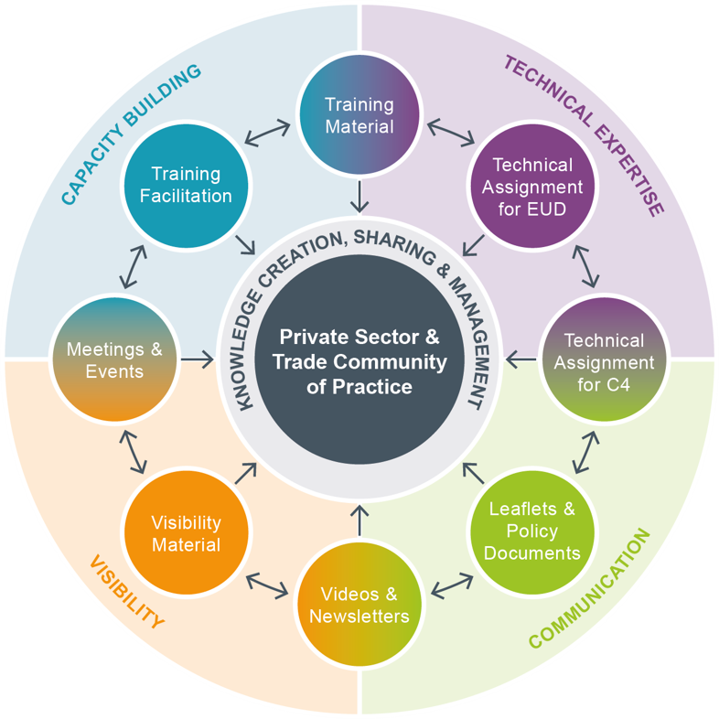
Emmanuel Moyart,
Team Leader, TPSD Facility
The TPSD Facility
Support DEVCO TPSD Thematic Unit, field and HQ
Research and publication: Private Sector Engagement in COVID-19 times

Slide 20
Emmanuel Moyart,
Team Leader, TPSD Facility
Support to MSMEs
Tunisia: Cash Transfer programme for MSMEs
€ 1.5M
MSME Treasury support
Conditional: Least developed regions, less than 10 employees, pledge to maintain jobs…

Slide 21
Emmanuel Moyart,
Team Leader, TPSD Facility
Support to MSMEs
Uganda: Banking and Capital Markets sectors, PPD
Renegotiate SME loans by the Yield Uganda Investment Fund
Fast track blended finance approvals
Speed up TA implementation and increas packages
Refocus portfolio on key sectors (tourism…)

Slide 22


Thank you and see you next week!
Presentations, recording of the webinar and related material available here.

